Slide 1


Hotel IN Saudi Arabia Booking.Com
:Prepared By
Nourah Albougami
Amjad Alammar
Bodoor Alroythi
Mashael Alzahrani
Naif Alsakhri

Slide 2


Time
Time
OUR FIRST OBJECTIVE IS FOR OUR COUNTRY TO BE A PIONEERING AND SUCCESSFUL GLOBAL MODEL OF EXCELLENCE, ON ALL FRONTS, AND I WILL WORK WITH YOU TO ACHIEVE THAT.

Slide 3

?Why To apply price control and make them competitive with the top countries attracting tourists around the world

Slide 4


Problem Understanding! OUR OBJECTIVE? - Help tourists and gov to know hotel prices in KSA. - Regulate prices and make them competitive. - Provide price predictions for hotels in most cities. -Help the hotels to improve their services - Unstable search results in some cities.
Who will benefit from Hotel Booking IN KSA analysis?
- Ministry of Tourism in Saudi Arabia
- Booking.com//sa
- Hotels Agencies
- Travel Agencies
- Customers

Slide 5

Plan of attack
1
2
3
4
Data Cleaning &
Prepatation
Handle nulls, zero
and duplicate
values.
Data Exploration
Visualize data and apply descriptive statistics.
Preprocess Data
Feature engineering & selection by applying transformations, scaling, and partitioning data to train, validate and test.
Build Models and test
fit several regression modeling algorithms with different combos of independent features, validate and test all models to get the best fit.

Slide 6

Data Preparation
We use the Hotel Booking IN KSA dataset from the Kaggle.
This data set contains booking information for a city hotel and includes information such as Price, Star Rating, Property Demand, Property id, Customers Rating, and Customers Review, Type of room, reservations Payment, Cancelation, Max persons, Bed type, Tax, Review title, Credit card, Link.

Slide 7


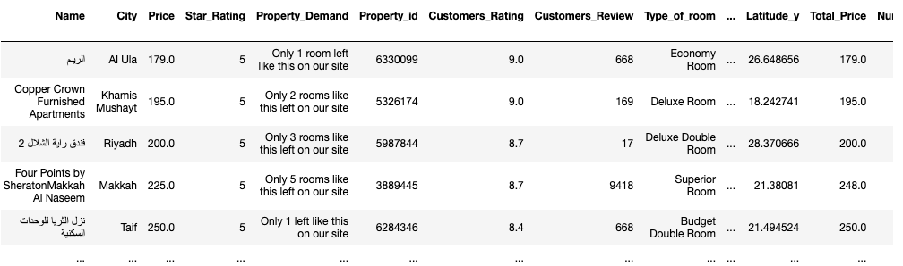
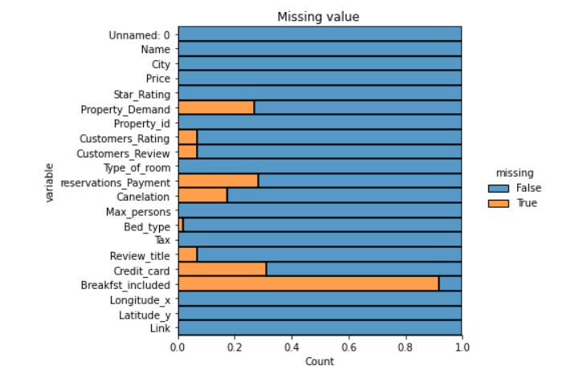

Slide 8
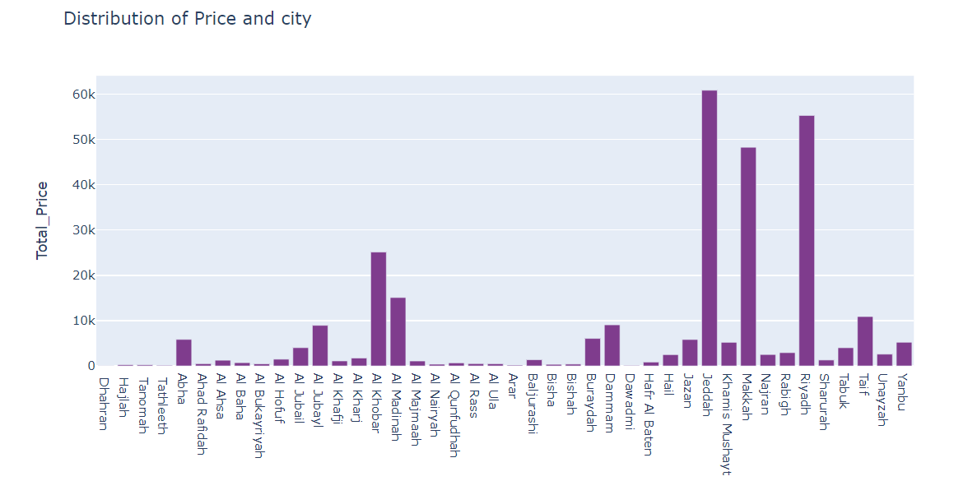
Data Exploration
The highest total price is in the following main cities

Slide 9
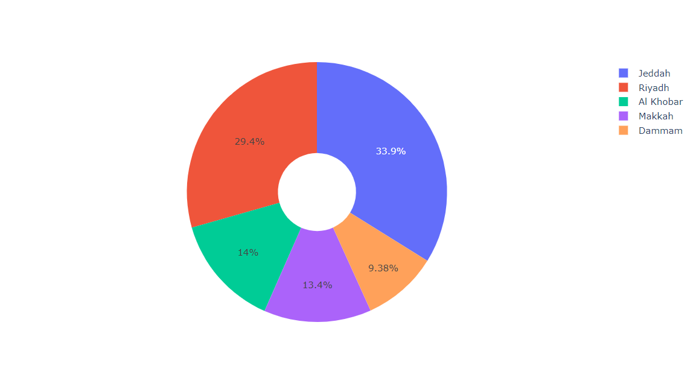
Data Exploration
The top 5 Cities by number of Hotels

Slide 10
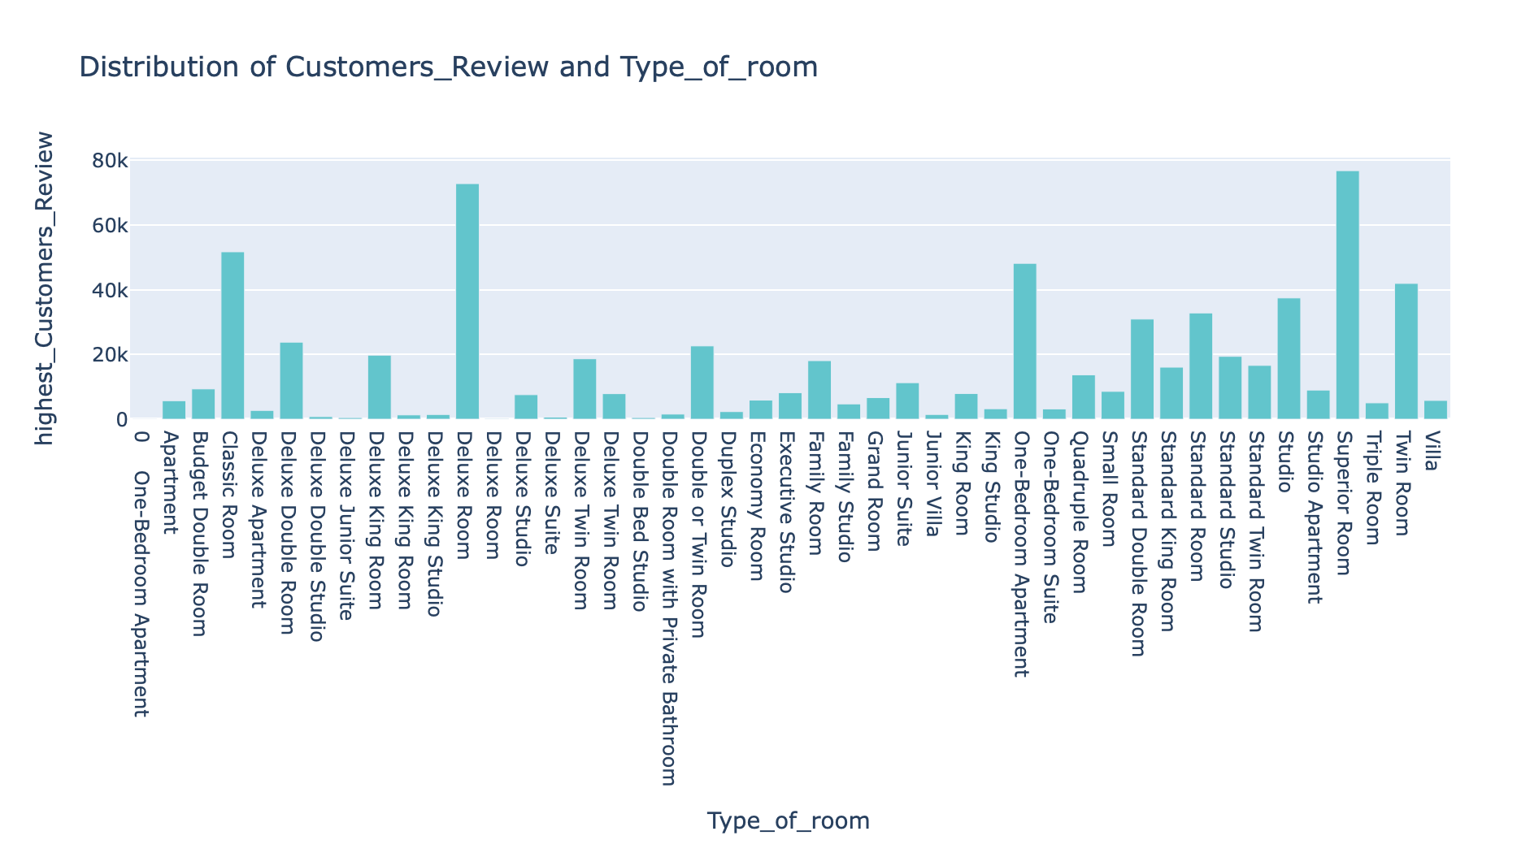
Data Exploration
The Highest customers review by the Type of Room

Slide 11
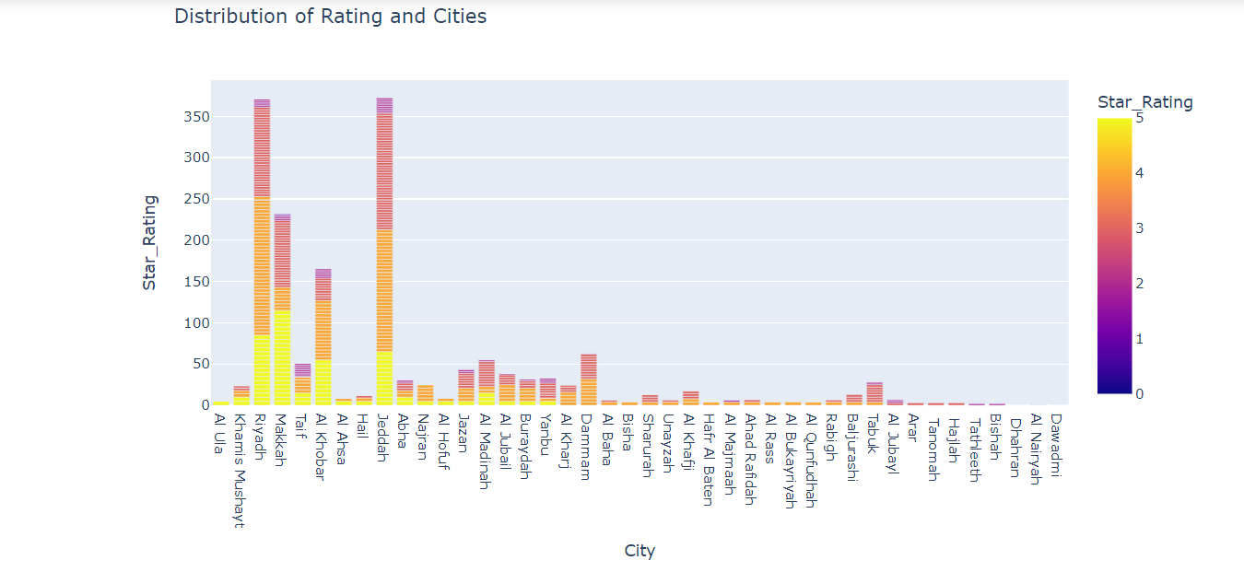
Data Exploration

Slide 12
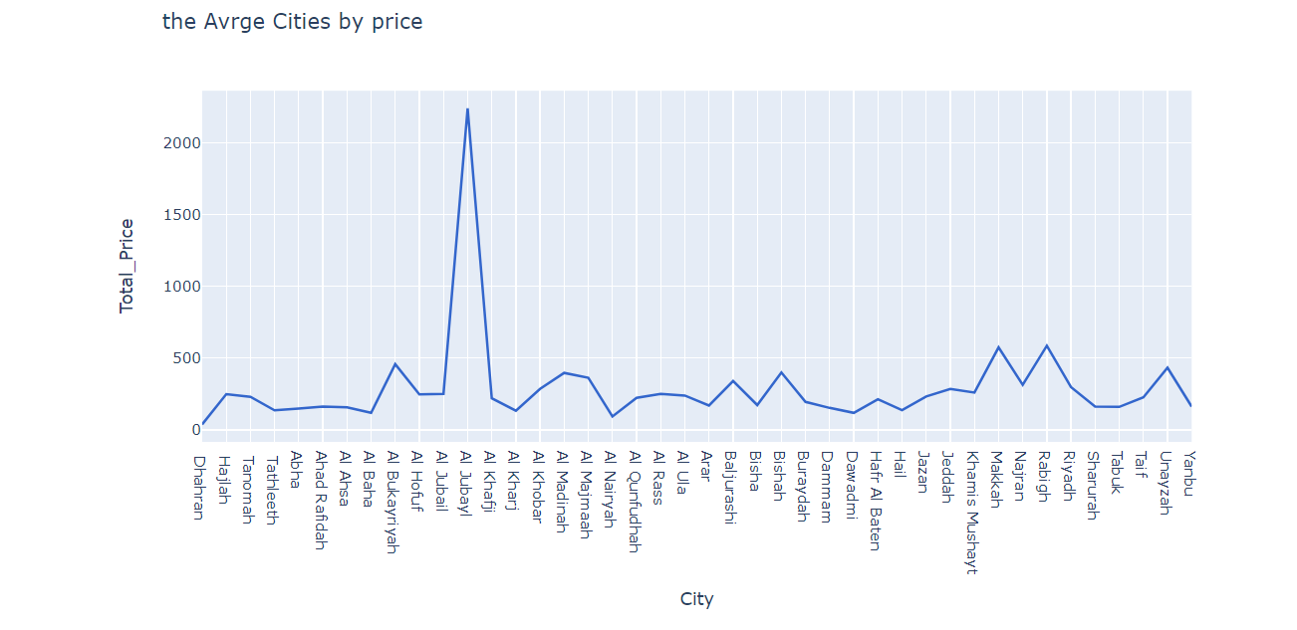
Data Exploration
The Average cities price

Slide 13
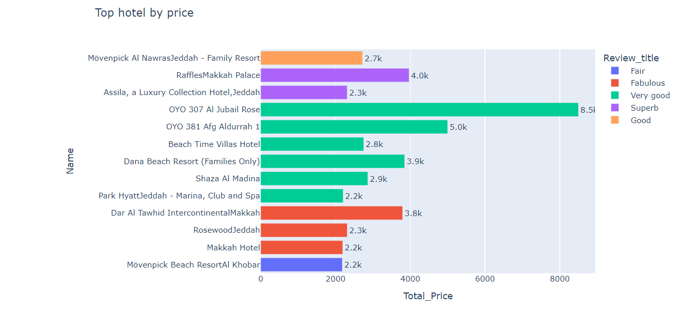
Data Exploration
The Top hotels price

Slide 14

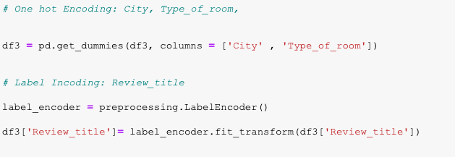
Building classification models
We started off with encoding our features:
1- One hot encoding: City and Type_of_room.
2- Label Encoding: Review Title

Slide 15

ML
Models
Linear Regression
Decision Tree
Random Forest
Support Vector

Slide 16
Building classification models
Out of the many regressors we have tried, two main regressor models are noted and compared and they are the XGBoost regressor and Random Forest Regressor.

Slide 17


Model Testing
Parameter Tuning:
Train-Validate-Test (split)
XGBoost Regressor
Random Forest Regressor
Grid Search for Hyper-Parameters

Slide 18
Best Model
Xgboost
RMSE: 211
MAE: 100
R2 score is 74%

Slide 19

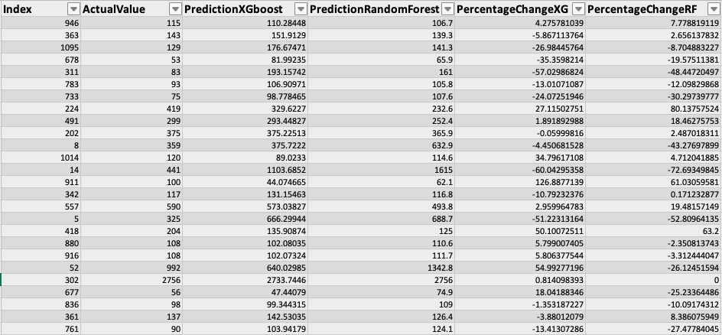
CERTIFICATE OF C O M P L E T I O N ?
Results of Models

Slide 20

Conclusion & Recommendation
Model building is iterative over time, to increase the accuracy it's a must.
Booking.com should handle false information and data entry about hotels in KSA.

Slide 21



Future Work
Increase the accuracy of the model by adding more relevant variables.
Adding more data from other online travel agencies platforms

Slide 22
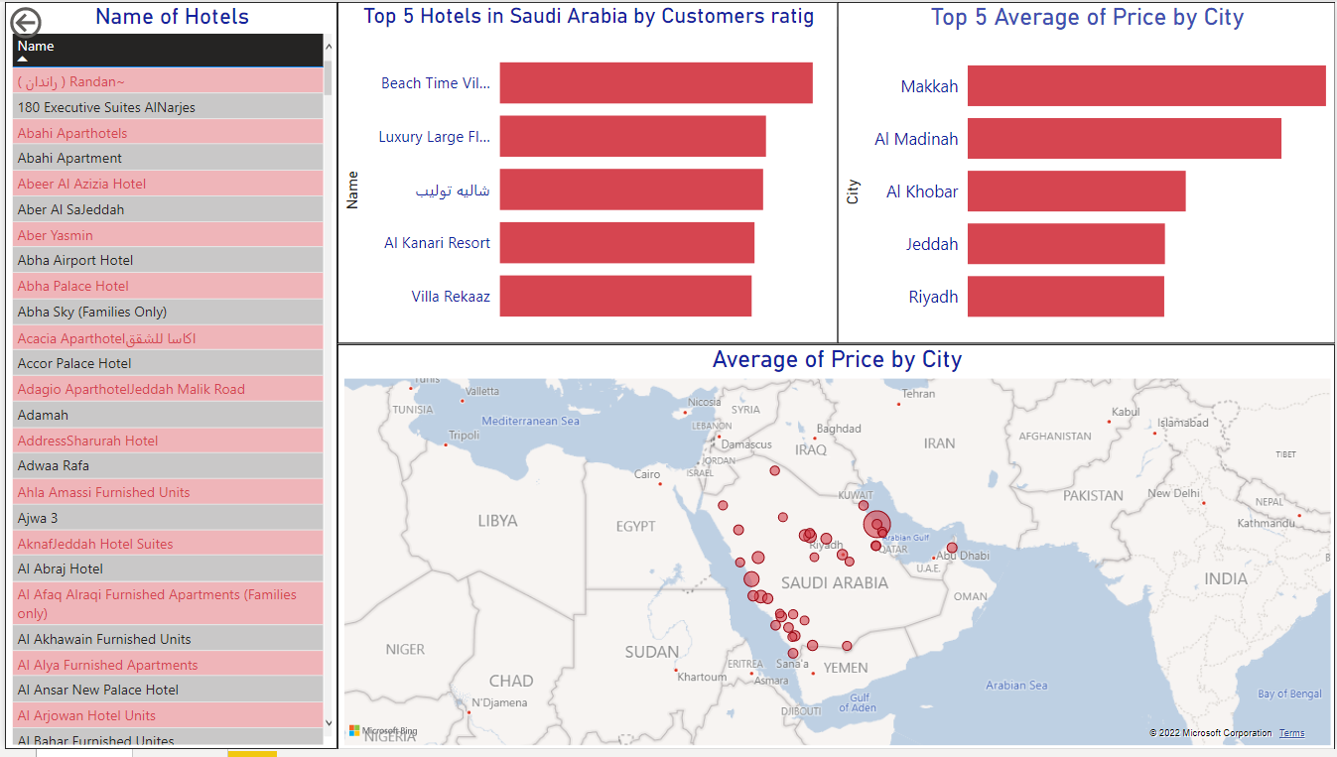
Dashboard

Slide 23


Thank You For Listening.
Do you have
any questions ?

